Slide 1

Understanding Book Banning Trends in the U.S
Conie O’Malley

Slide 2

Agenda Items
Data Types
Data Description
Data Retrieval & Cleaning
Data Visualization

Slide 3
Data Types

Slide 4

Primary data types: full-text book content and thematic metadata
Full-Text Book Content
Full-text book content encompasses the entire text of banned books, providing a comprehensive view for analysis.
Source: Project Gutenberg
Thematic Metadata
Thematic metadata includes categorization and contextual information, aiding in understanding the significance of each book.
Source: Google Books

Slide 5
Data Description

Slide 6

Dataset includes 20 banned books
Florida
Wuthering Heights
Iowa
The Picture of Dorian Gray
The Taming of the Shrew
Helen of Troy
Leonardo Da Vinci
The Road
The Pirate
The Dark Tower
Redeemed
Monster
The Heir
The Talisman
The Great Return
Smoke
The Best Man
Glass
Redeemed
The Bridge
Monster
Dead End
Total Number of Banned Books
The dataset consists of 20 banned books, highlighting censorship issues faced in different regions.
Equal Representation
The 20 banned books include an equal representation of 10 from Florida and 10 from Iowa, ensuring balanced analysis.
Comparative Analysis
This dataset allows for a comparative analysis of censorship trends between Florida and Iowa, showcasing differing attitudes.

Slide 7
Data Retrieval Process

Slide 8
Initial sampling limitations due to full-text availability
Limited Full-Text Access
The availability of full-text content for certain banned books was limited, posing challenges for our research.
Selection Process Challenges
We had to implement a careful selection process to ensure access to complete texts for our analysis.
Importance of Complete Texts
Accessing complete texts was crucial for a comprehensive analysis of the banned books in question.
53 texts from Florida and 16 texts from Iowa were available from Project Gutenberg
Full sampling led to too few texts being available on the open web
Limited sampling to texts available on Gutenberg to allow for full text analysis
Without full texts, this study would be a underwhelming thematic analysis

Slide 9

Text Retrieval from project gutenberg
Gutenbergr Package
The retrieval phase successfully acquired six books using the gutenbergr package, demonstrating its effectiveness.
Project Gutenbergr Website
The remaining fourteen were accessed by creating a function in r to download the full texts directly from the Project Gutenberg website
Data Comparison
The data from the gutenbergr package was much cleaner. All data from Project Gutenberg’s website had to be cleaned and preprocessed before being put into data frames

Slide 10

Text Retrieval from Google Books
Web Scraping
Unsuccessful attempt to scrape the data after writing code in both r and python – I believe I was hitting firewalls and could not verify my humanity
Google Books API
I attempted to use my Google Books API key to gather the descriptions and subjects, but could not pinpoint the exact texts with enough accuracy to use this method for all data collection
ChatGPT
I queried ChatGPT to pull the descriptions and subjects of each text and write to a UT-8 CSV file which I read into r and was able to join to my full texts data set

Slide 11
data cleaning tasks: removing HTML spacing, extra whitespace, chapter labels, stopwords, punctuation, symbols
Standardization & Initial Cleaning
Convert all text to lower case for consistency
Inspect the dataset for missing values (NA) and adjust processing functions accordingly.
Structuring & Tokenization
Tokenize text into individual words and multi-word sequences (n-grams) for analysis.
Iterative Cleaning & NA Handling
Remove punctuation, special characters, and excessive whitespace to prevent formatting errors.
Apply stopword removal to eliminate high-frequency, low-value words.
Identify and remove Gutenberg boilerplate text and chapter headings that remained after initial cleaning.
Three iterations of cleaning to refine text processing and ensure completeness.
Apply lemmatization to reduce words to their base forms (e.g., “banning” → “ban”).
Validate and restructure the final cleaned dataset to ensure compatibility with term frequency analysis and machine learning models.

Slide 12
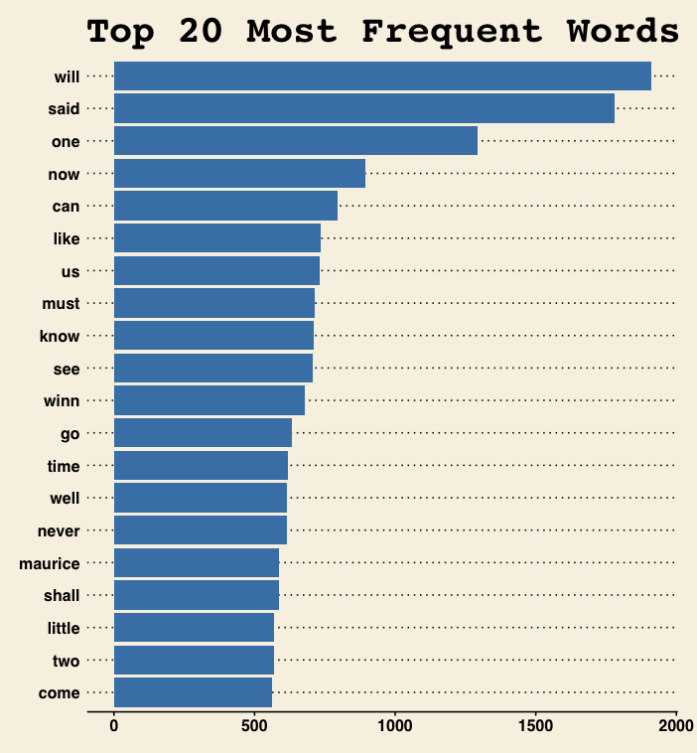
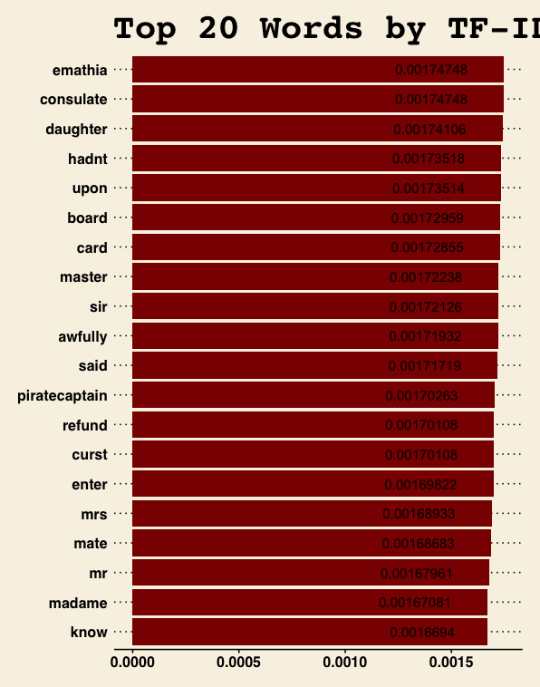
Initial data visualization
Term Frequency Analysis
The top 20 most frequent words in both Florida and Iowa datasets primarily consist of common function words such as will, said, and one.
The TF-IDF scores reveal unique words with higher importance in specific documents, such as piratecaptain, refund, and consulate in Florida, and sadhearted, telemacho, and evidence in Iowa.
TFI-IDF Analysis
While frequent words highlight general trends, they often include stopwords or generic terms that do not provide direct insight into censorship themes.
Unlike raw term frequency, TF-IDF helps isolate meaningful terms that are distinctive to individual books, offering a clearer perspective on censorship-related language patterns.

Slide 13

term frequency, and inverse document frequency (TF-IDF) for analysis
Bigram Vectors
Preparing trigram vectors is crucial for analyzing text data and understanding contextual relationships within the text.
Term Frequency Calculation
Calculating term frequency helps identify how often specific terms appear in documents, providing insights into their significance.
Inverse Document Frequency
Inverse document frequency measures the importance of a term across multiple documents, helping to filter out common terms.
TF-IDF for Analysis
TF-IDF combines term frequency and inverse document frequency to enhance text analysis and uncover hidden patterns.

Slide 14
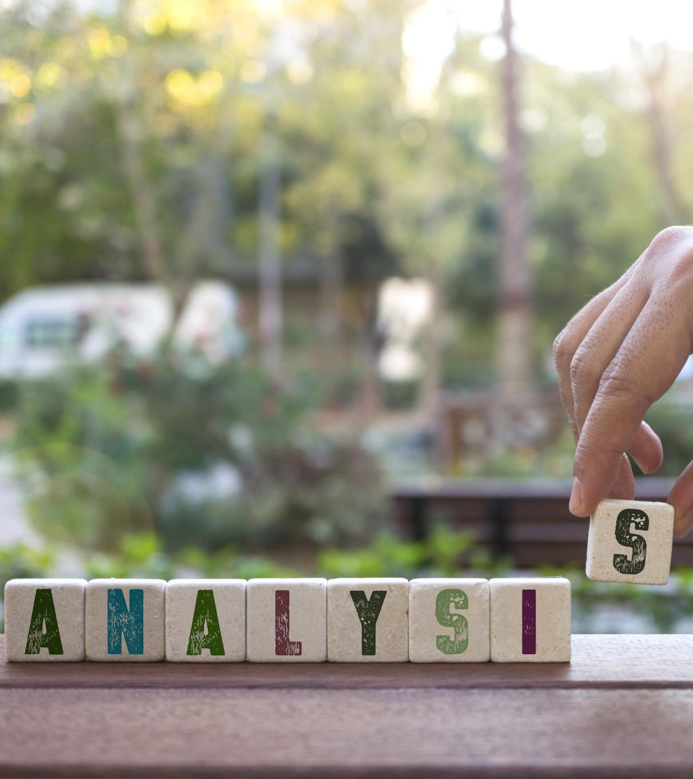
The Way Forward: Analyzing Banned Books
Bigram Analysis
Subgroup Comparison
Model Development
Generate bigram vectorization to capture frequently occurring phrases.
Identify common bigrams in banned book descriptions across Florida and Iowa.
Compare bigram patterns to determine recurring censorship themes and linguistic markers.
Conduct a comparative analysis between Florida and Iowa’s banned book datasets.
Assess regional differences in censorship themes and justifications.
Identify patterns in author demographics, subject matter, and political influences across states.
Train a classification model to predict whether a book is likely to be banned based on textual features.
Use TF-IDF scores, trigrams, and metadata as input features for predictive modeling.
Evaluate model performance with accuracy, precision-recall metrics, and confusion matrices to ensure reliability.

Slide 15
Conclusion
Analyzing Censorship Trends
Continuing to examine banned books in Florida and Iowa, identifying key linguistic and thematic patterns through text mining.
Overcoming Data Challenges
Data retrieval and cleaning required multiple iterations to refine text preprocessing and ensure accurate term frequency analysis.
Implications & Next Steps
Findings will inform predictive modeling to assess censorship risk and contribute to discussions on intellectual freedom and policy impact.

